Slide 1
Creational Patterns

Slide 2
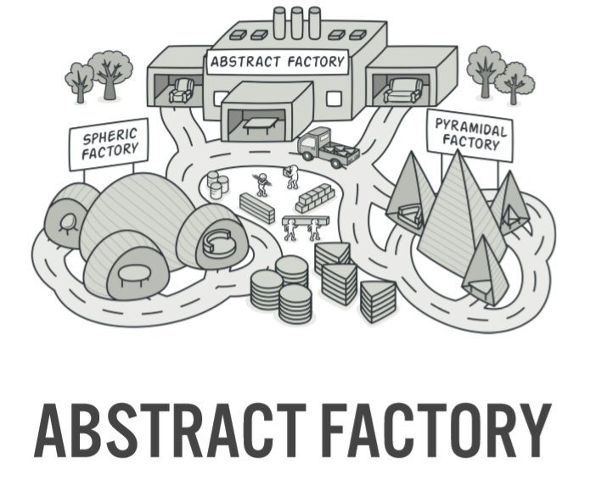

Slide 3
Abstract Factory is a creational design pattern that lets you produce families of related objects without specifying their concrete classes.

Slide 4
Intent
Provide an interface for creating families of related or dependent objects without specifying their concrete classes.
A hierarchy that encapsulates: many possible "platforms", and the construction of a suite of "products".
The "new" operator considered harmful.

Slide 5
Problem
If an application is to be portable, it needs to encapsulate platform dependencies. These "platforms" might include: windowing system, operating system, database, etc. Too often, this encapsulation is not engineered in advance, and lots of #ifdef case statements with options for all currently supported platforms begin to procreate like rabbits throughout the code.

Slide 6
Discussion
Provide a level of indirection that abstracts the creation of families of related or dependent objects without directly specifying their concrete classes. The "factory" object has the responsibility for providing creation services for the entire platform family. Clients never create platform objects directly, they ask the factory to do that for them.
This mechanism makes exchanging product families easy because the specific class of the factory object appears only once in the application - where it is instantiated. The application can replace the entire family of products simply by instantiating a different concrete instance of the abstract factory.
Because the service provided by the factory object is so extensive and general, it is routinely implemented as a Singleton.

Slide 7
Structure
The Abstract Factory defines a Factory Method per product. Each Factory Method encapsulates the " new " operator and the concrete, platform-specific, product classes. Each "platform" is then modeled with a Factory derived class.

Slide 8
Example: in java

Slide 9
